Slide 1

Breaking the shell
‘The chick does not break the egg out of hatred for the shell; it does so out of a desire to live under a wider heaven’.
DH Lawrence, early draft of The Rainbow
Creative Commons license 2010-2025 RedQuadrant – attribution required benjamin.taylor@redquadrant.com 079 3131 7230
Developed from an activity at www.squarewheels.com
Notes:
1

Slide 2
The future is bright
We are all ambitious for the vision we have outlined.
Things are going to change – we have an opportunity to set things up better, and get rid of some frustrations with the way we’ve done things in the past.
But there are a number of challenges in the way of achieving the vision.
They might come from the way we traditionally do things, from personal and political relationships, from citizens, from policy changes… from all kinds of directions.
This session is about identifying those challenges and understanding them better, so we know how to deal with them.
Notes:
2

Slide 3
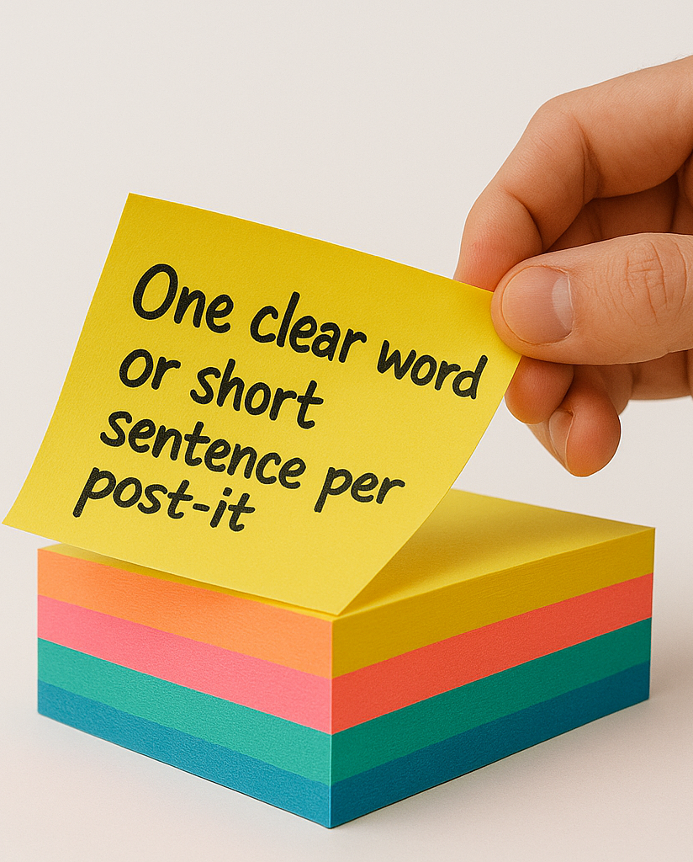
Getting out all the barriers to change
Imagine we are now meeting again – we’ve failed.
We’re doing the post-mortem.
You each have a post-it pad.
Please write down the reason why we failed.
In fact, write as many challenges/barriers to achieving the vision as you can think of.
You have two minutes.
The more ideas, the better.
Use a sharpie.
Rectangular post its.
Peel diagonally.

Slide 4
Clustering the barriers
Put all the post-its onto one flipchart.
Where there are duplicates, ‘stack them’.
If subjects are very similar, overlap.
Otherwise, put them close if related, further away if not.

Slide 5
Categorising the barriers
Notes:
5

Slide 6
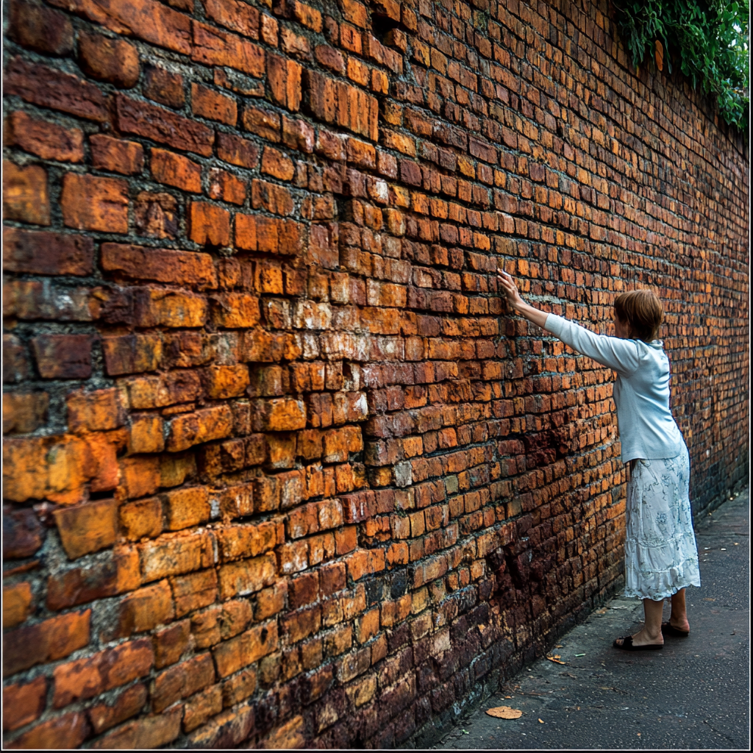
Brick walls
A really unalterable challenge. Things in the real world facing us that inhibit performance and are not likely to change.
This could be government or legal requirements, regulatory requirements, demographic changes, money market or international issues, high-level political developments.
These factors affect performance in delivering our service, but are well beyond individual or collective control.
Brick walls are immovable and real.
They are part of the bigger system.
Perhaps we should be campaigning to change them,
but that’s all we can do!
‘Can’t be changed’
Notes:
6

Slide 7
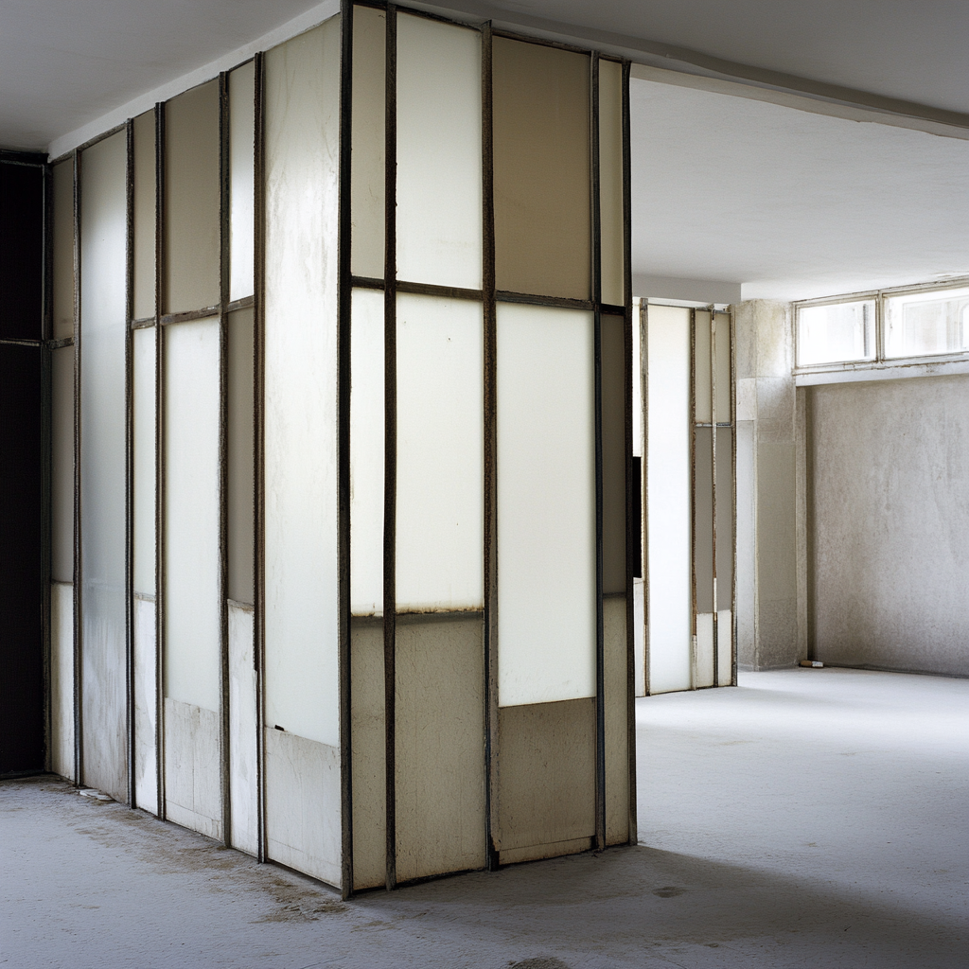
‘Partition’ walls
These challenges can be managed through with effort, time, money and/or additional personnel, or other resources.
An individual might make some progress in dealing with this sort of challenge. Management might overcome the challenge totally – corporate management certainly should be able to.
Partitions might move slightly if pushed from the bottom, but if pushed from a higher level will often topple. We need help with these. This is something in the system that needs changing.
Examples include legacy, political, and structural issues.
‘We can change’

Slide 8

Paper walls
This looks like a real barrier – until you test it. Then, you realise you can simply push through it.
Paper walls might exist because you think someone else will not approve, that it won't be supported by another part of the organisation, that it is 'policy' or the way things have always been done, etc.
But when you test this belief, you discover it isn’t true – others have done things differently and are doing things differently.
These challenges are manageable, but also real. This is something you can change about yourself, for yourself.
‘I can change’

Slide 9

‘Mindset’ challenges
This type of challenge is based on untested beliefs and perceptions – like collective papers walls.
When you believe you can't, you are correct. These are the ones that block the below average from improvement.
Like paper walls, but this is something we need to change together.
Examples of this sort might include not feeling that you can pool resources across departmental or organisational boundaries, or seeing citizen and political complaints as a problem rather than positively.
‘Innovate to change’

Slide 10
Breaking the shell: types of challenges
Brick walls
External and unalterable challenges which affect performance and are
not likely to change.
Can’t be changed
Partitions
Challenges that can be overcome with extra effort, time, money or people. Individuals might make progress, groups of employees can make more, management can overcome them totally.
We can change
Paper walls
Look like real challenges – until you test them. Then you realise you can simply push through them on your own, and others have already done so. Might exist because it is ‘policy’ etc.
I can change
Mindset challenges
The most difficult to deal
with – untested beliefs
and perceptions. When you believe you can't, you are correct. Something that needs
to be changed collectively.
Innovate to change
Creative Commons license 2010-25 RedQuadrant – attribution required benjamin.taylor@redquadrant.com 079 3131 7230
Developed from an activity at www.squarewheels.com
Notes:
10

